Slide 1
да
машинное обучение
Нет
Здравствуйте
A Simple Text-Translator Based on LSTM
Rus - Eng
Machine Learning
Group 2: Runhai XU (James)
Zhaohang YAN (Martin)
Shiyu FAN (Leo)
Yes
Thank you

Slide 2
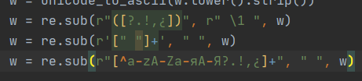

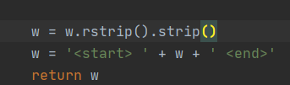
Sentence Preprocessing
Turn sentence to the code that machine can handle
Clean the sentences by removing special characters.
Pad sentence to maximum length with 0.
Create index number for every word in sentence
Add <start> and <end> token
Handle Punctuation
Create Tokens
Zero Padding
Create Word Index
Seq2Seq
The training dataset comes from http://storage.googleapis.com/download.tensorflow.org/data/rus-eng.zip, this dataset contains 330k pairs of Rus-Eng sentences

Slide 3
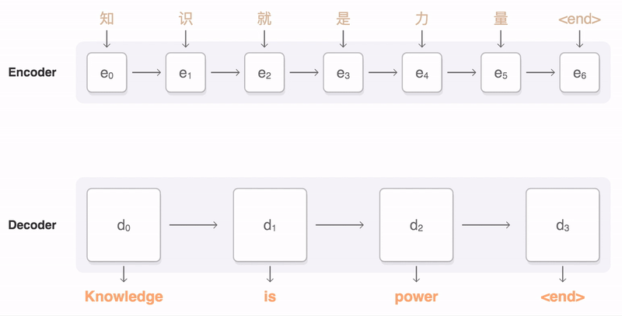
Seq2Seq
For text translation, the input sequence and output sequence usually are not equal
RNN/LSTM
Attention Module
Teaching Force

Slide 4
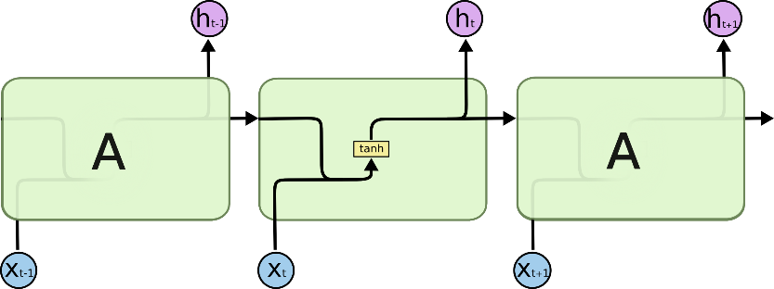

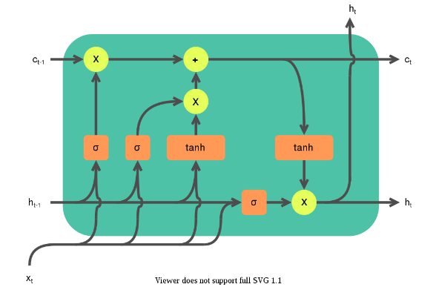
From RNN to LTSM
LTSM struct create a new
ht-1 will be passed from the previous cell to the next cell,
However such dependency will not be remembered for a long term.
How about GRU?

Slide 5
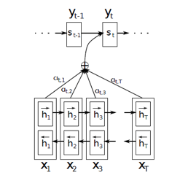
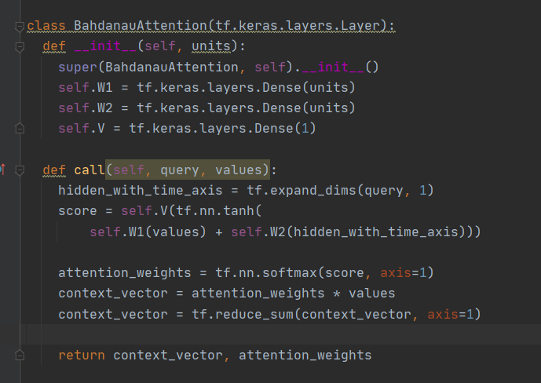
Teacher forcing and Attention Module
Teacher forcing : It does not use the output of the previous state as the input of the next state each time, but directly uses the previous item corresponding to the ground truth of the training data as the input of the next state.
Attention Module: Assign attention weights to all the outputs of the context vector and use them as one of the inputs of the decoder in turn.

Slide 6
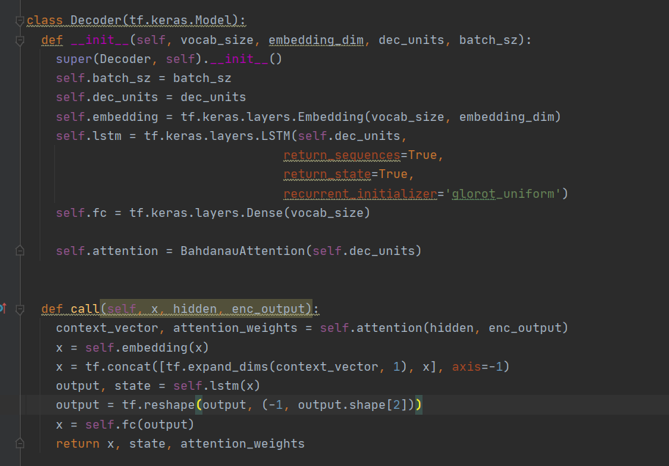
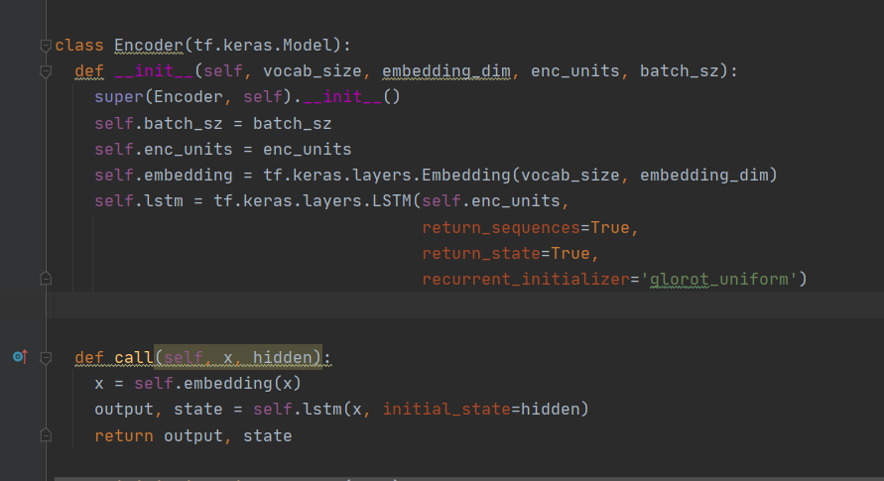
Encoder
Decoder

Slide 7
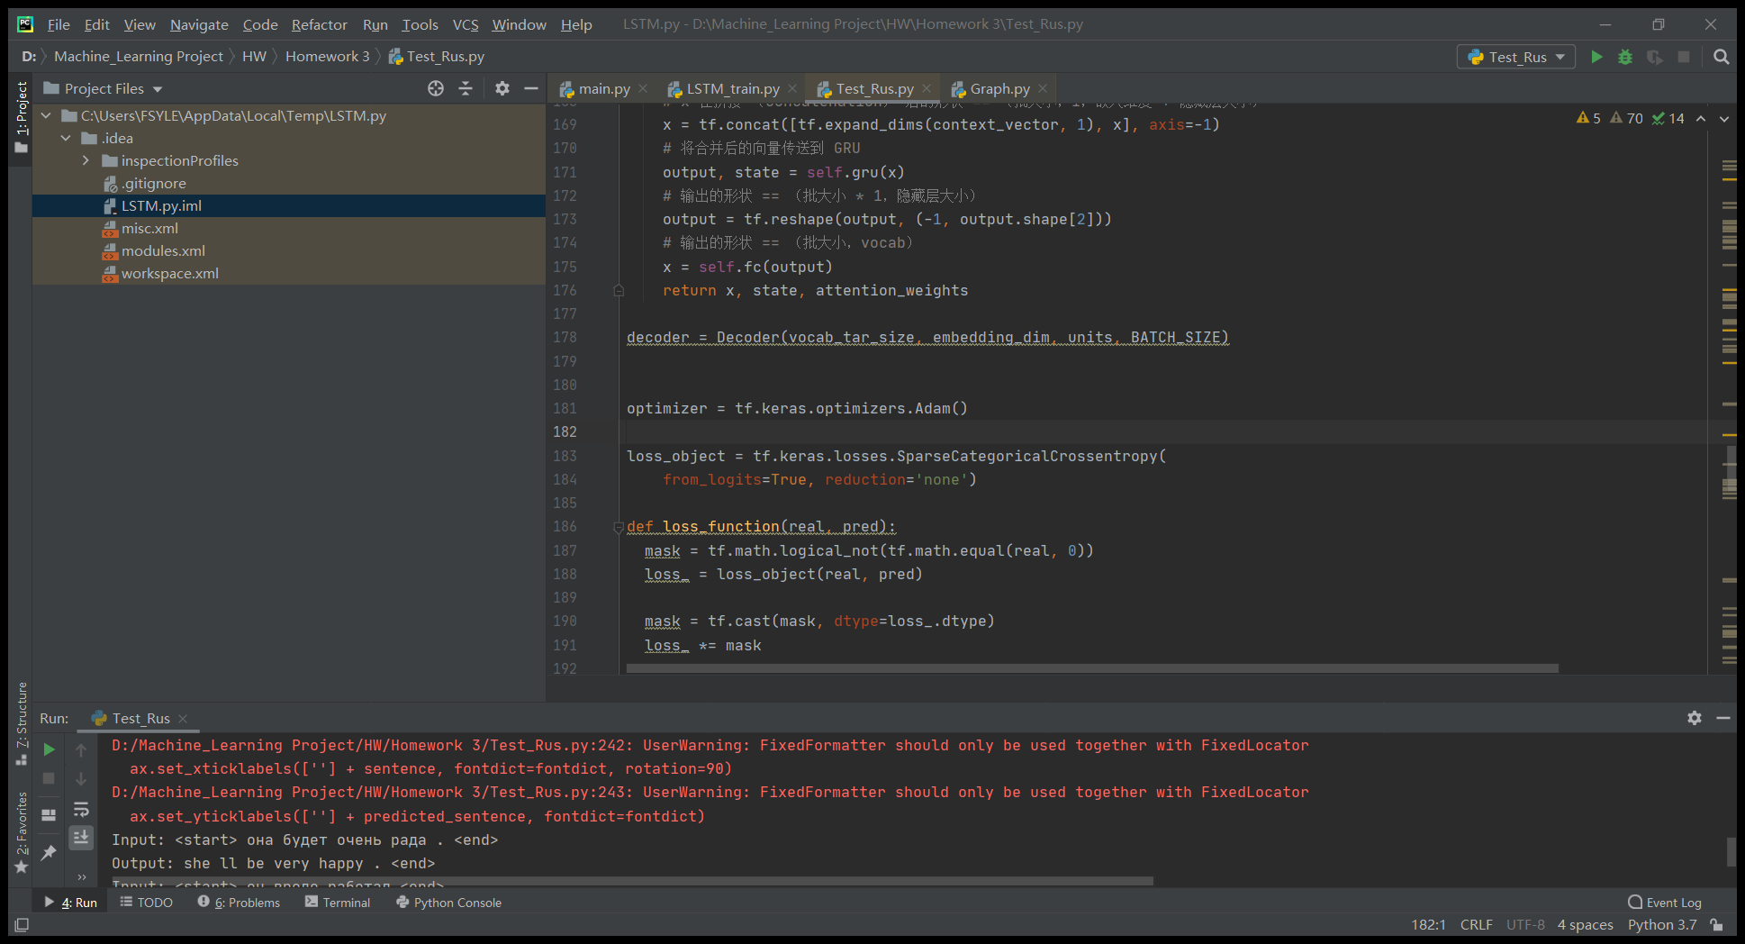
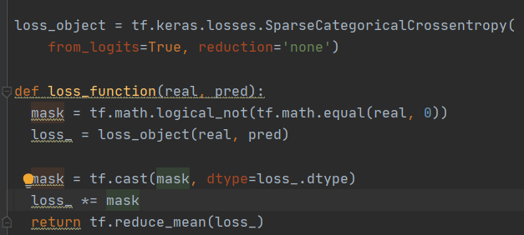

Optimizer and Loss Function
Optimizer：Adam optimization algorithm
Loss Function: Cross Entropy Loss Function + Mask
Cross Entropy Loss for Classifier,
Mean Squared Error for Linear Regression
Why?

Slide 8
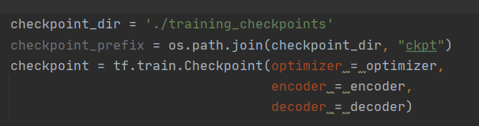
Train and Save Model
With CheckPoint
Traning Data: 50k pairs of sentences
Batch Size: 64
Units: 1024
Embedding: 256
Initial_State: LSTM.Zero_State
Save Model as CheckPoints
Restore Model from CheckPoints
(Need reconstruct network)

Slide 9
Test
Rus - Eng
TestCase: 10
Correct: 1
Error: 9
KeyError: 3
TranslationError：4
GrammaticalError：2
10%
In Russian, Nouns. Nominal declension involves six cases – nominative, genitive, dative, accusative, instrumental, and prepositional – in two numbers (singular and plural), and absolutely obeying grammatical gender (masculine, feminine, and neuter).

Slide 10



Testcase Example
Wrong!
‘It's my pleasure.’
Wrong!
‘You did by yourself.’
Correct!
Some cases even cannot be translated correct by Google Translate!

Slide 11
References
“Understanding LSTM Networks” https://colah.github.io/posts/2015-08-Understanding-LSTMs/
“Neural machine translation with attention” https://www.tensorflow.org/tutorials/text/nmt_with_attention
“Seq2Seq” https://google.github.io/seq2seq/
Dzmitry Bahdanau, Kyunghyun Cho, Yoshua Bengio (2015). “Neural Machine Translation by Jointly Learning to Align and Translate” ICLR 2015
Hochreiter, S.; Schmidhuber, J. (1997). "Long Short-Term Memory". Neural Computation. 9 (8): 1735–1780.

Slide 12
Thanks!
Спасибо!

